Slide 1
Fitness Tracker Team No:- 163 Project No:- P14
Sanjay M 22BIT0518
Namandip Raj 22BCE11371
Chirag Choudhary 22BCE10993
Snehil Kumar Amber 22BCE11225

Slide 2
Introduction
Brief Outline:
The Fitness Tracker is a health and lifestyle web application designed to help users track their daily fitness activities, water intake, diet, and body composition easily.
Built using the MERN stack (MongoDB, Express, React, Node.js), it ensures a modern, responsive, and interactive user experience
Users can:
Log daily weight, calories, and steps.
Track water intake with reminders.
Get daily motivational quotes.
Monitor macronutrients (carbs, proteins, fats) with a visual pie chart.
Predict body composition (body fat, lean mass, water percentage)
Use a built-in focus timer for productivity during workouts or study.

Slide 3
Objectives:
Encourage users to build healthy habits by visualizing daily progress.
Integrate nutrition and fitness tracking in one place.
Provide easy-to-use, visually appealing, and mobile-friendly tracking tools.
Support personalized, data-driven fitness goals through seamless tracking and visualization.
Build a scalable, real-world MERN application ready for deployment and further enhancements.

Slide 4
Link to access
LIVE DEPLOYMENT FRONTEND
VERCEL FRONTEND DEPLOYMENT
RENDER BACKEND DEPLOYMENT
RENDER DEPLOYMENT ML MODEL
GITHUB LINK
GIT FRONTEND
GIT BACKEND
GIT ML MODEL

Slide 5
Project Objectives
Goals:
Build a user-friendly fitness tracking application for daily health monitoring.
Enable logging of workouts, water intake, diet, and body metrics easily.
Provide data visualization (charts, graphs) for clear progress tracking.
Incorporate ML-based body composition predictions for personalized health insights.
Ensure secure user authentication with JWT and efficient CRUD operations.

Slide 6
Expected Outcomes:
Users can track and visualize their daily fitness and nutrition data intuitively.
Improved awareness of daily calorie, macronutrient, and water intake goals.
Ability to predict body composition to adjust workouts and diet plans.
A responsive, scalable, and clean MERN application ready for deployment on cloud platforms.
Users feel motivated with visual progress and daily motivation boosts.

Slide 7
Individual Contributions
Sanjay M 22BIT0518 : FRONTEND & DEPLOYMENT FOR ALL PAGES
Namandip Raj 22BCE11371: BACKEND & MONDODB MAINTAINANCE
Chirag Choudhary 22BCE10993 : API CALLING
Snehil Kumar Amber 22BCE11225 : MACHINE LEARNING MODEL FOR BMI

Slide 8
Key Concepts
MongoDB:
Stores user data, fitness entries, water intake, and food macros securely and efficiently.
Express.js:
Backend REST API creation for managing user authentication, CRUD operations, and ML model communication.
React.js:
Frontend with clean, interactive UI, real-time updates, and dynamic charts for progress tracking.
Node.js:
Server environment handling API requests, routing, and connecting all backend operations seamlessly

Slide 9
JWT Authentication:
For secure login and session management.
Tailwind CSS:
For responsive, modern UI styling without bloat.
Integration with ML Model:
Provides body composition prediction inside the MERN workflow.
Charts & Visualizations:
Using React libraries for real-time macro and fitness tracking graphs.

Slide 10
Challenges and Solutions
Problem 1: Data Handling & API Integration
Description:
Integrating ML model predictions and fitness data with MongoDB while maintaining real-time updates on the frontend was challenging.
Resolution:
Utilized Express API endpoints and React useEffect hooks effectively to sync MongoDB data with the frontend. Ensured ML Flask API responses were handled with proper error management for a smooth user experience.

Slide 11
Problem 2: Responsive UI with Multiple Widgets
Description:
Fitting macro tracker, water intake, daily motivation, and timer widgets on the dashboard while ensuring a clean, non-cluttered user interface was difficult.
Resolution:
Implemented Tailwind CSS fixed positioning with responsive breakpoints. Added hover-based expansions and shading to highlight active widgets, keeping the dashboard professional and user-friendly.

Slide 12
Lesson learned
Technical Insights
Learned to build and deploy a full MERN stack application with ML model integration.
Practiced REST API creation using Express and MongoDB, handling secure authentication and CRUD operations.
Gained experience in responsive UI design using Tailwind CSS with React for a clean, engaging interface.
Understood deployment pipelines using GitHub and Render, including environment variable handling for secure production.
Integrated Flask ML microservices with the MERN backend, learning real-time prediction handling.

Slide 13
Lesson learned
Process Insights
Practiced structured project planning and modular coding, ensuring features were added systematically.
Learned the value of clear branching and commit practices using Git for clean collaboration and rollback safety.
Improved debugging skills while integrating multiple technologies (React, Node, MongoDB, Flask).
Understood the importance of user-centric design, balancing technical complexity with ease of use.
Managed testing and iteration cycles systematically, strengthening time management under deadlines.

Slide 14
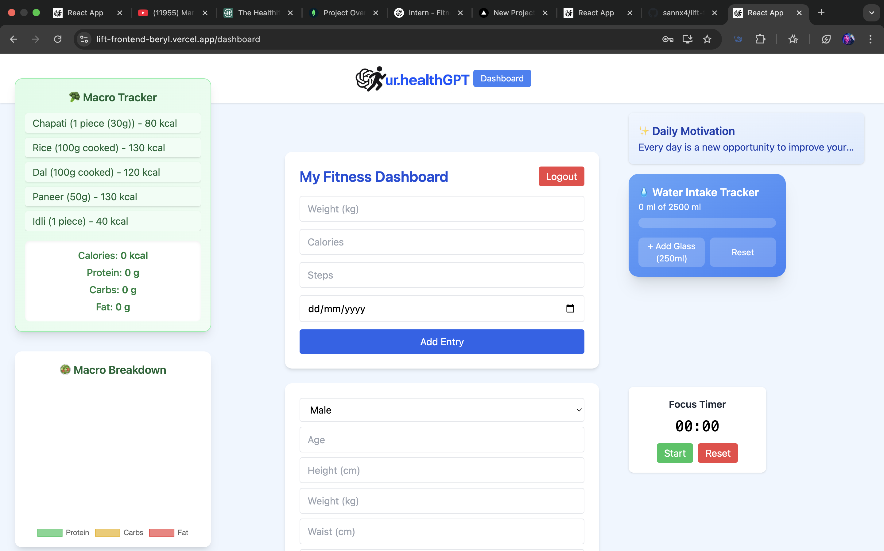
SCREENSHOTS
DASHBOARD OF THE FITNESS TRACKER

Slide 15
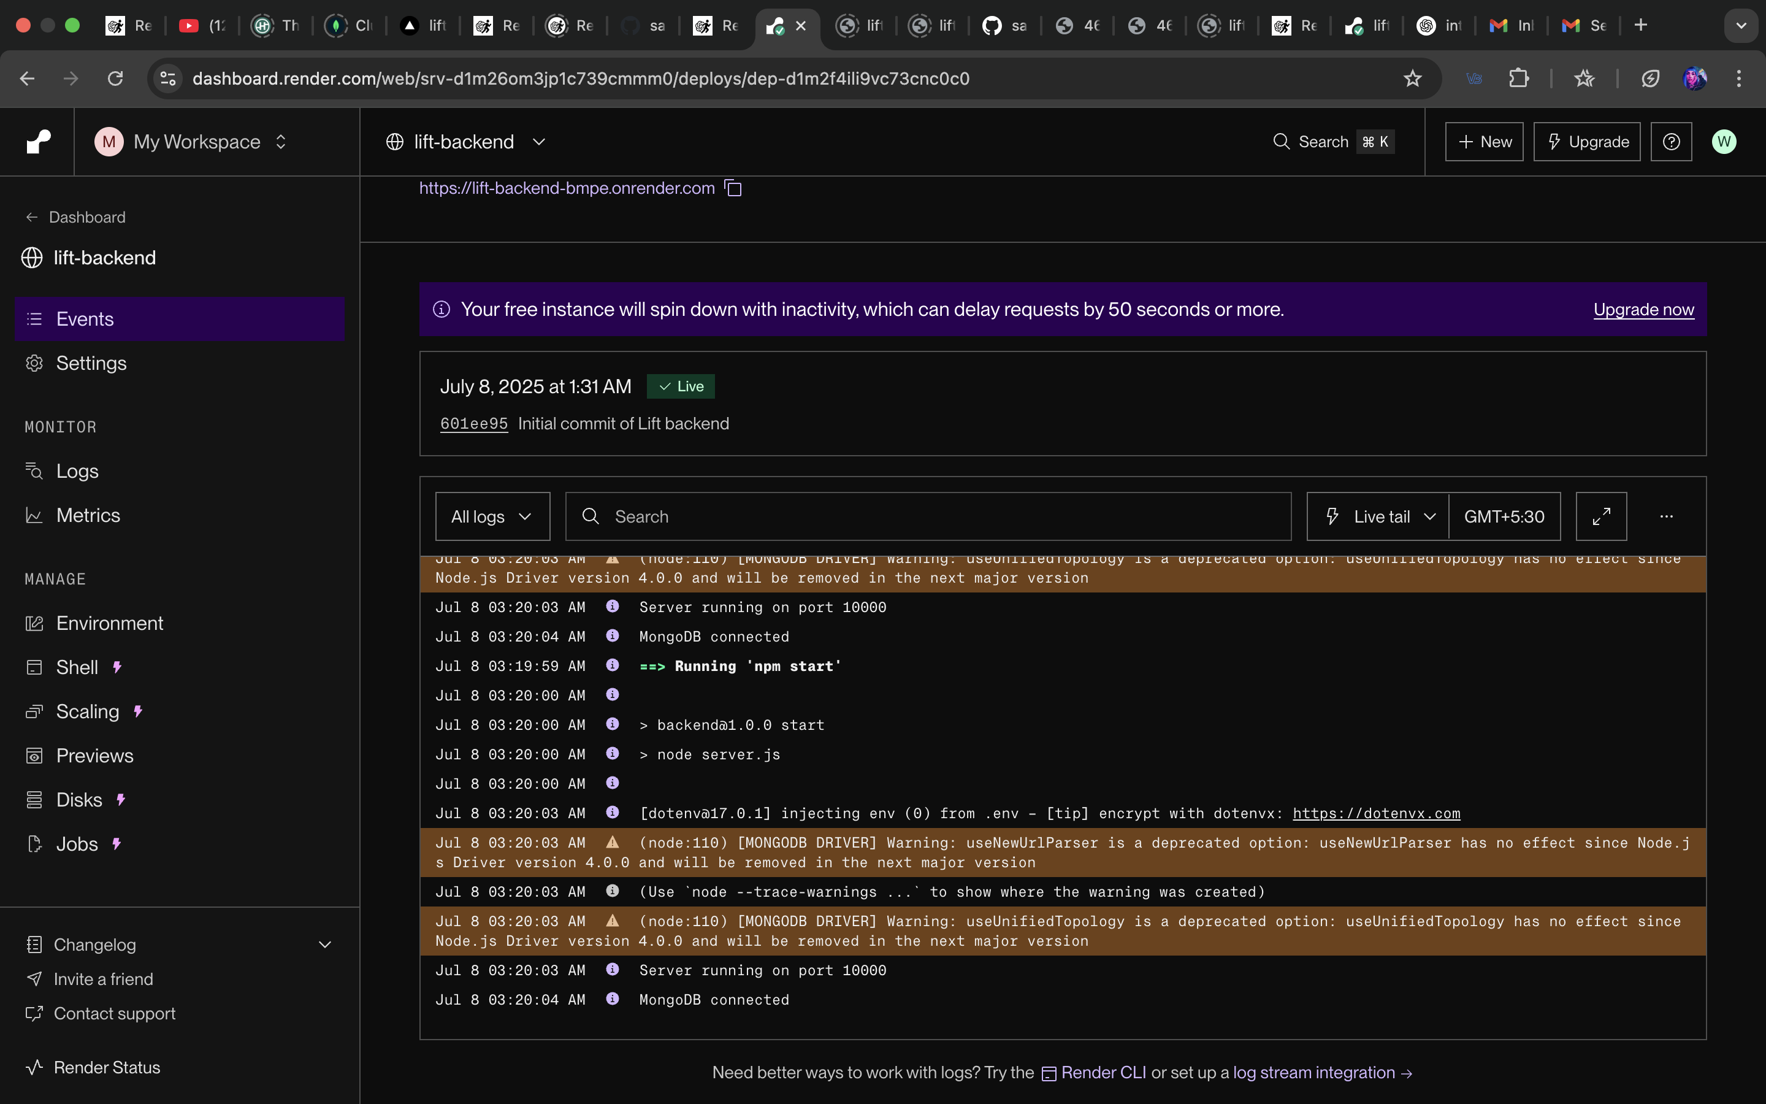
RENDER DEPLOYMENT OF BACKEND FILE

Slide 16
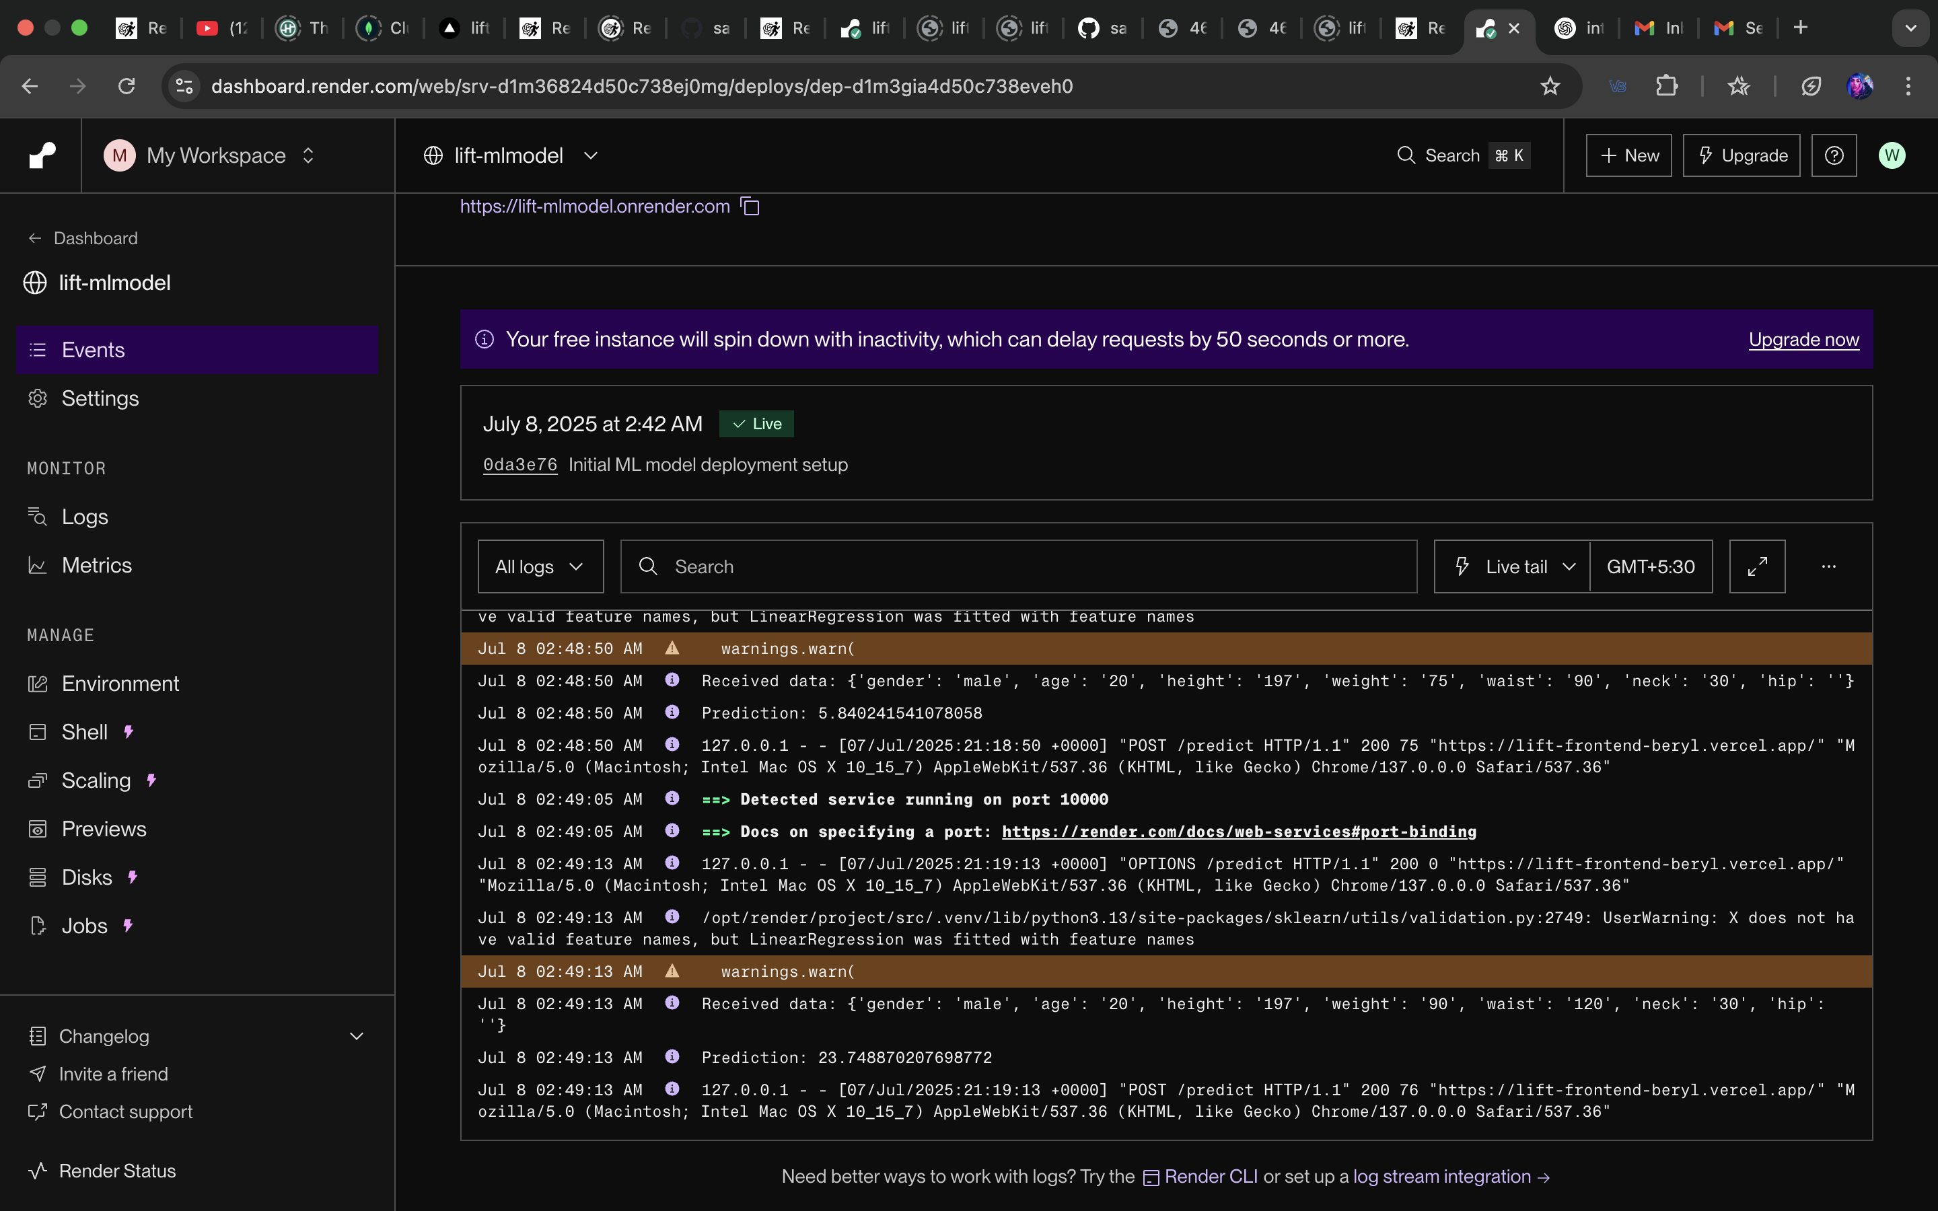
_{RENDER DEPLOYMENT OF MLMODEL}

Slide 17
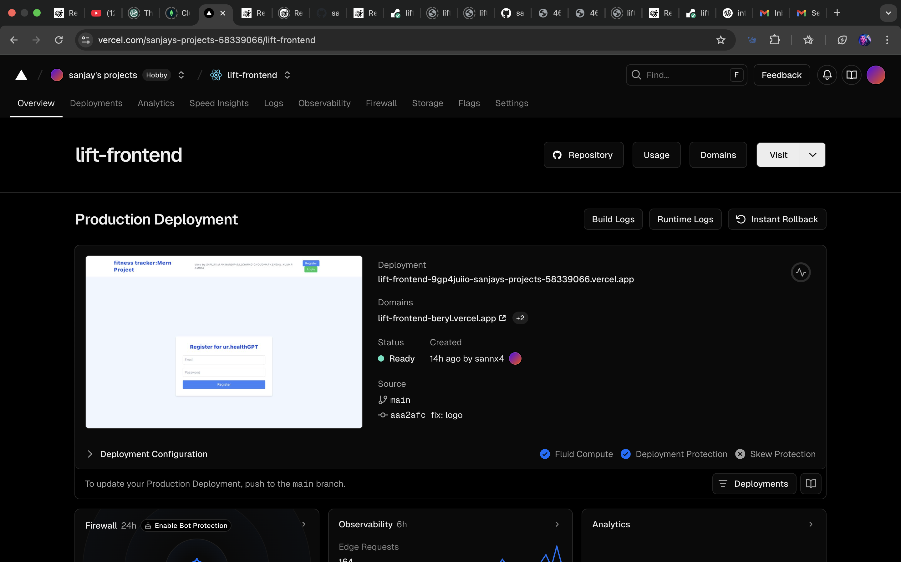
_{VERCEL DEPLOYMENT OF FRONTEND}

Slide 18
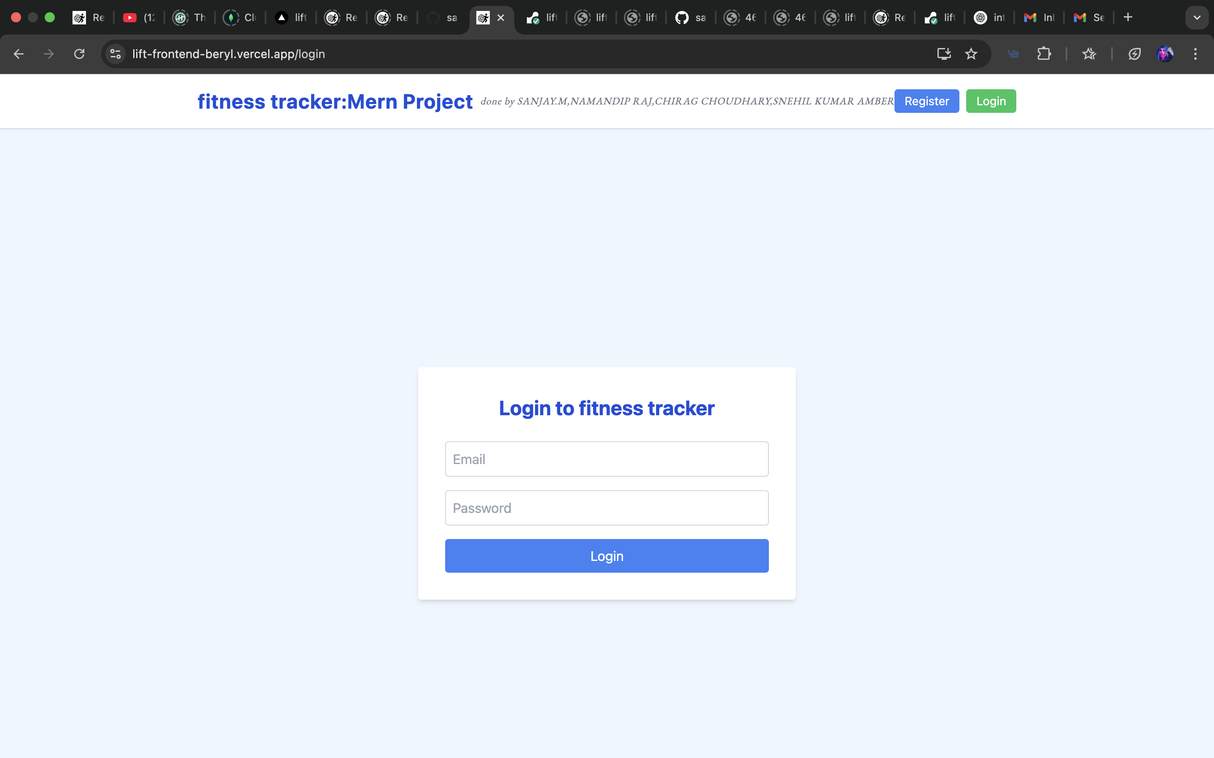
login page : https://lift-frontend-beryl.vercel.app/login

Slide 19
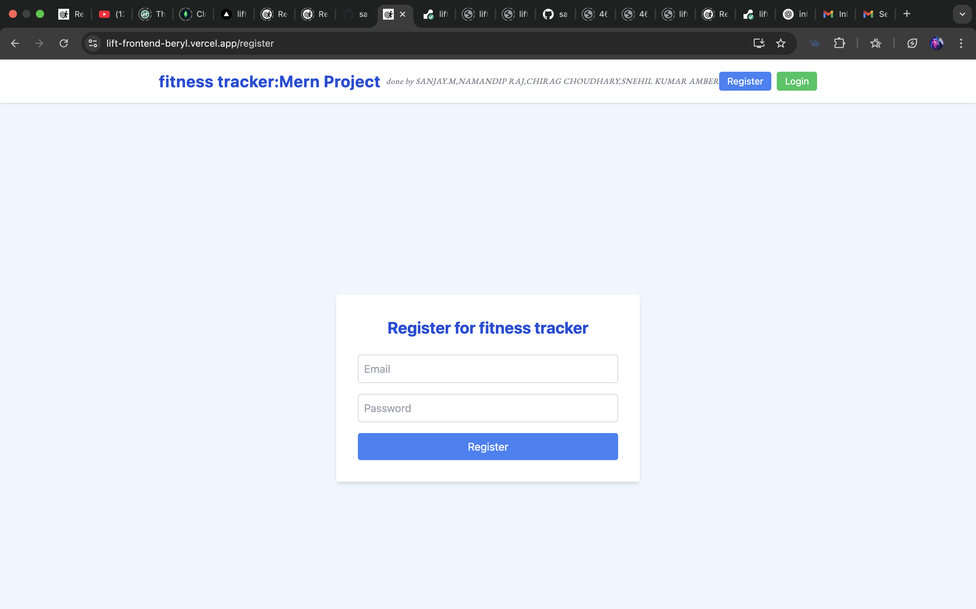
register page : https://lift-frontend-beryl.vercel.app/register

Slide 20
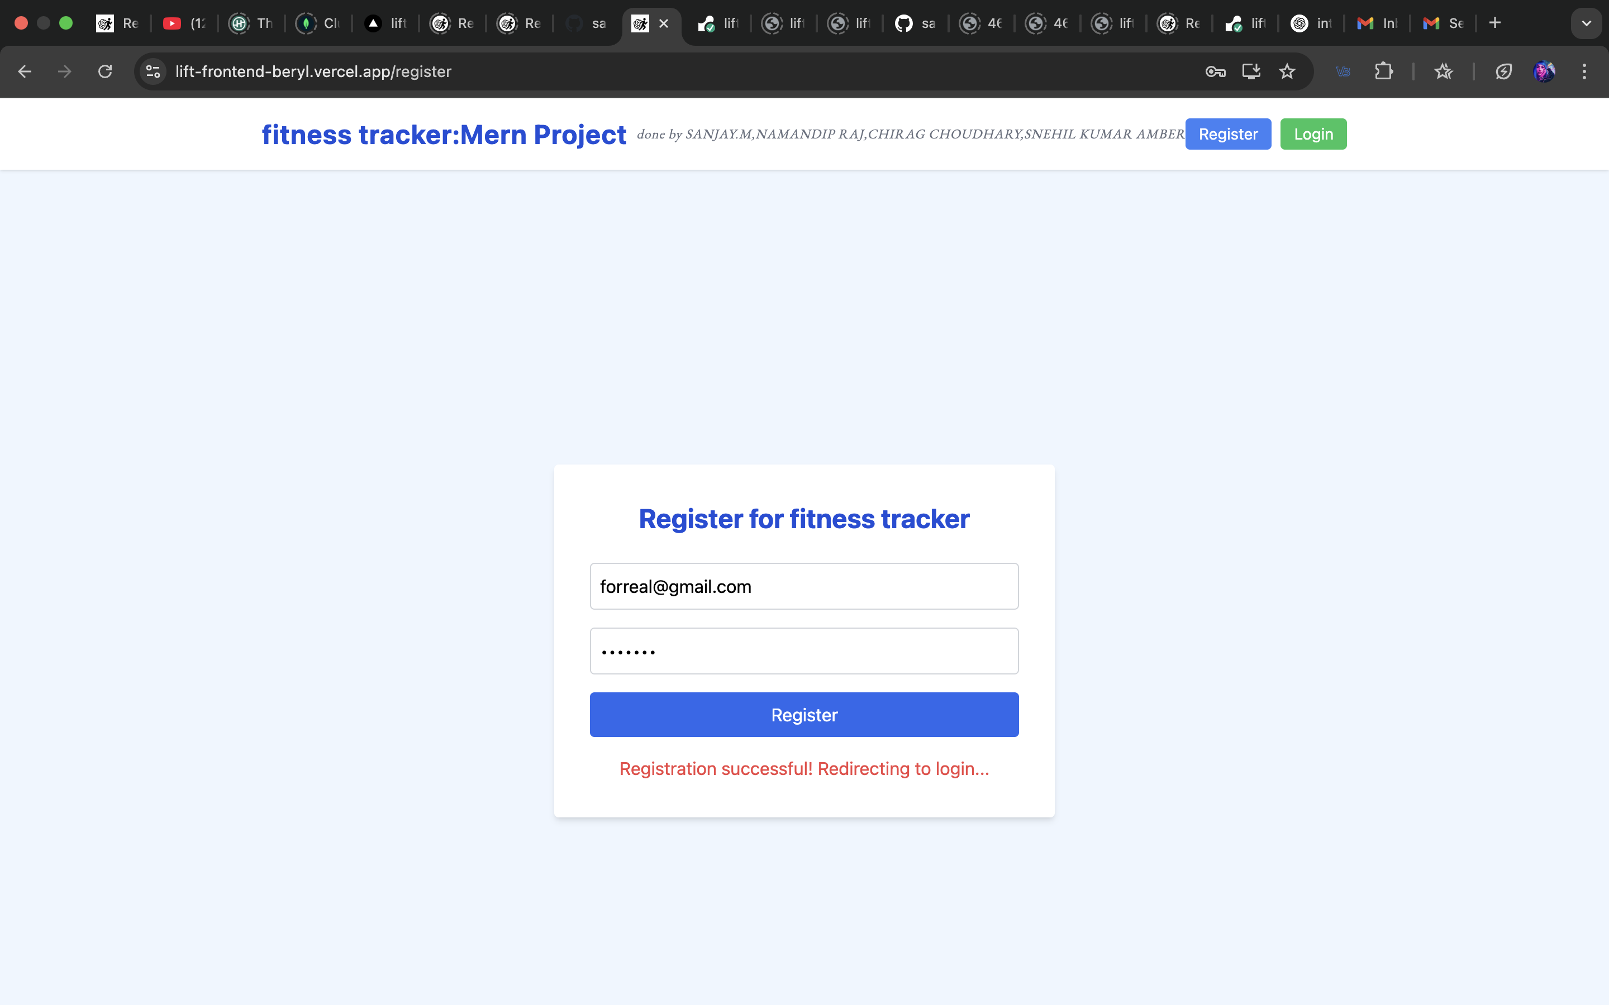
_{registration process}

Slide 21
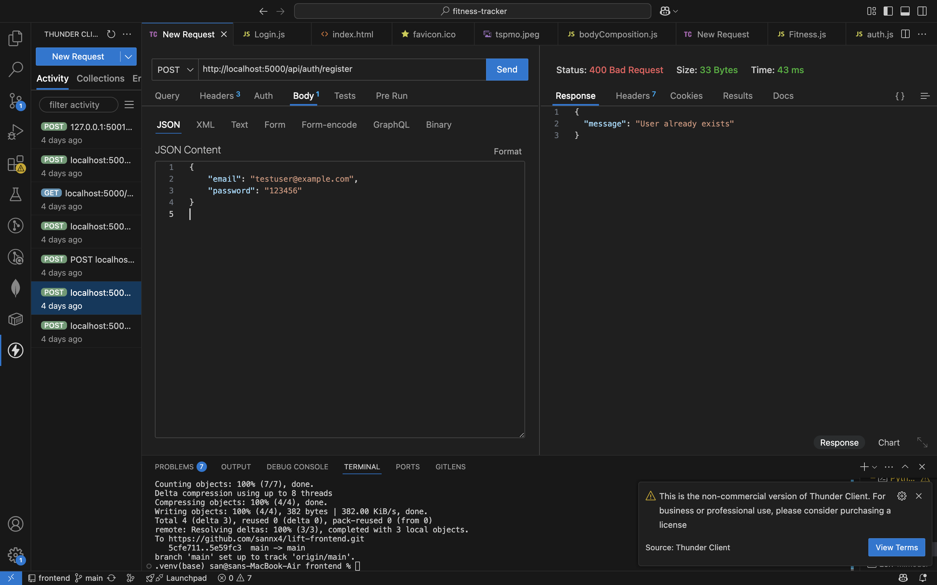
_{api testing:login}

Slide 22
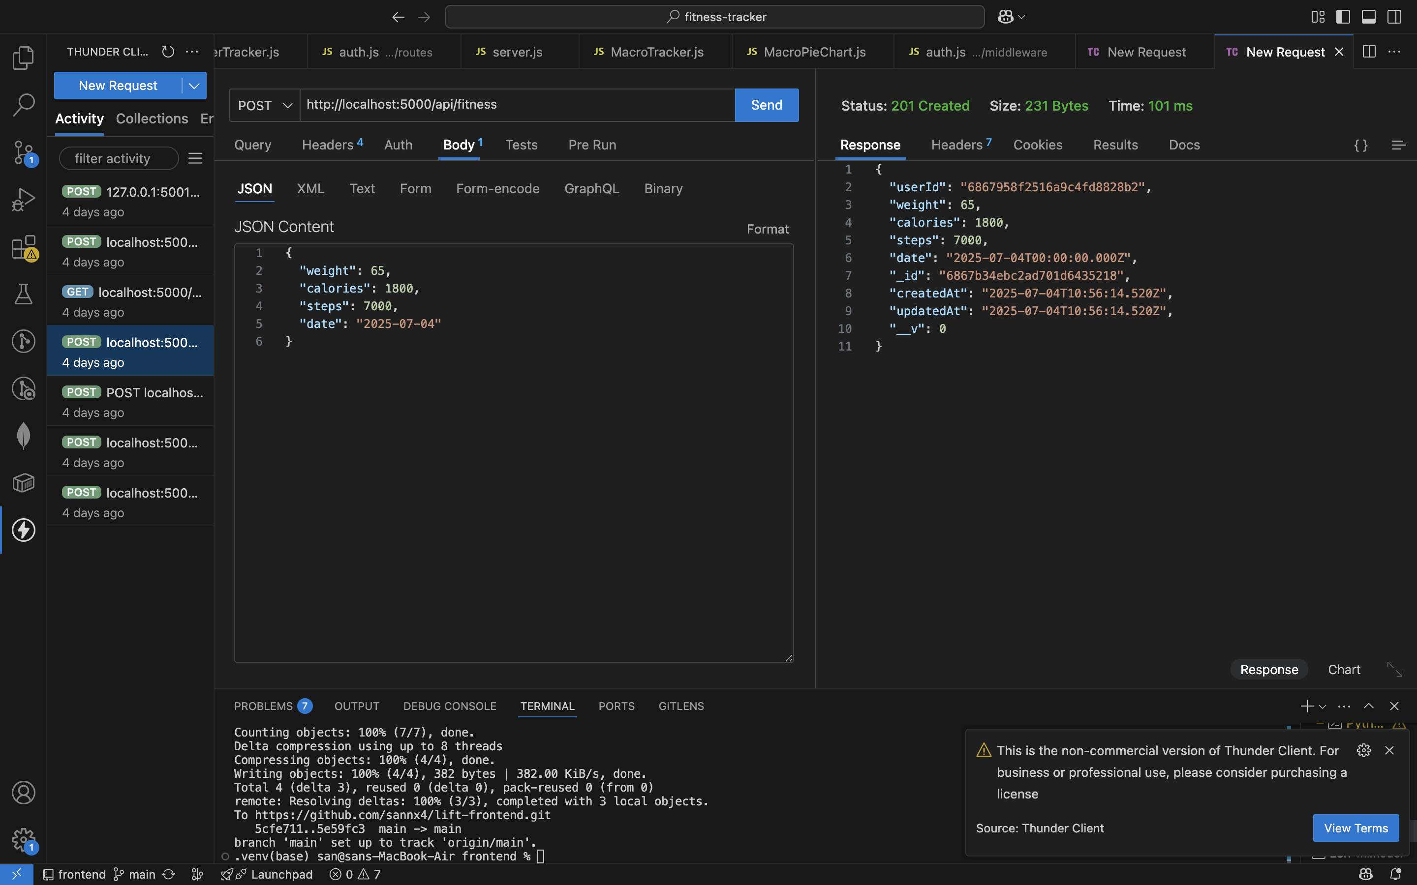
api testing: my fitness dashbaord

Slide 23
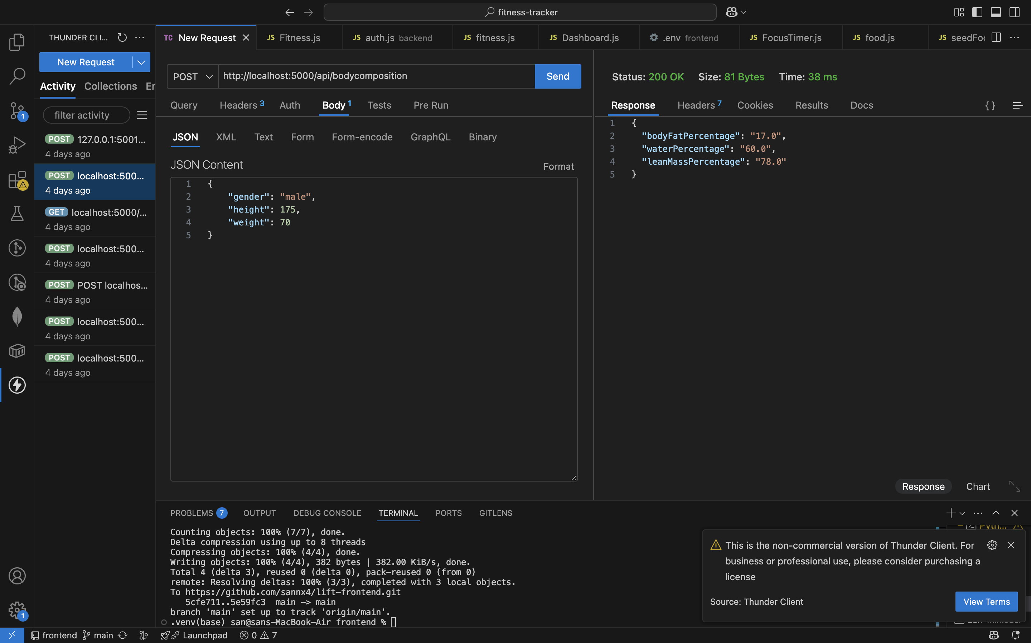
_{api testing: bmi}

Slide 24
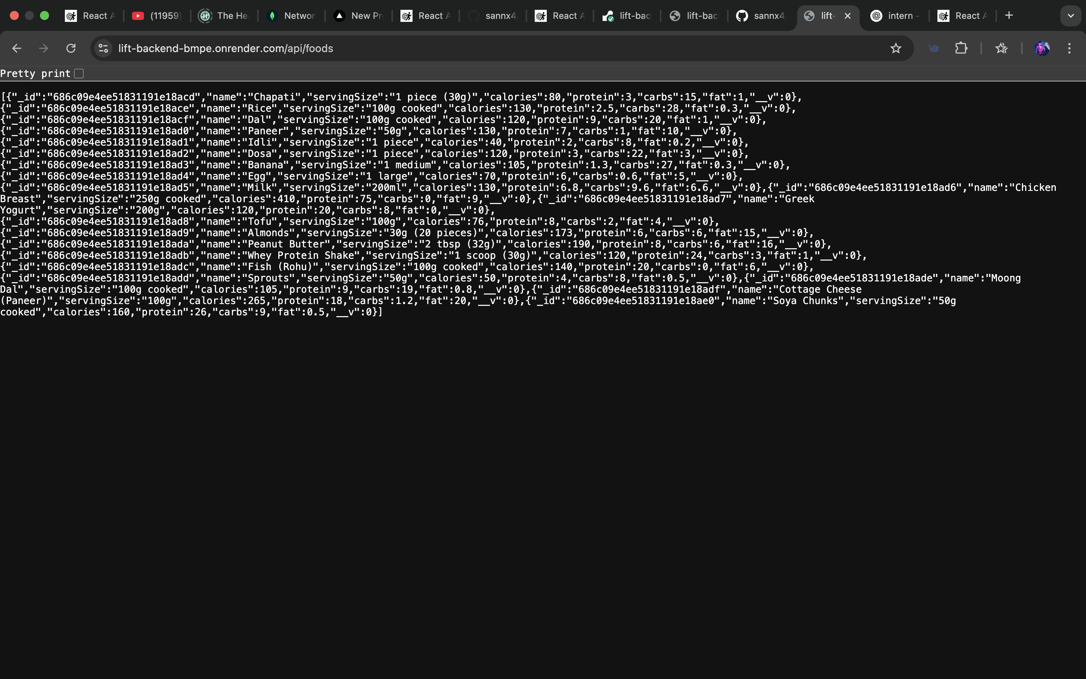
_{backend food macro storage:}

Slide 25
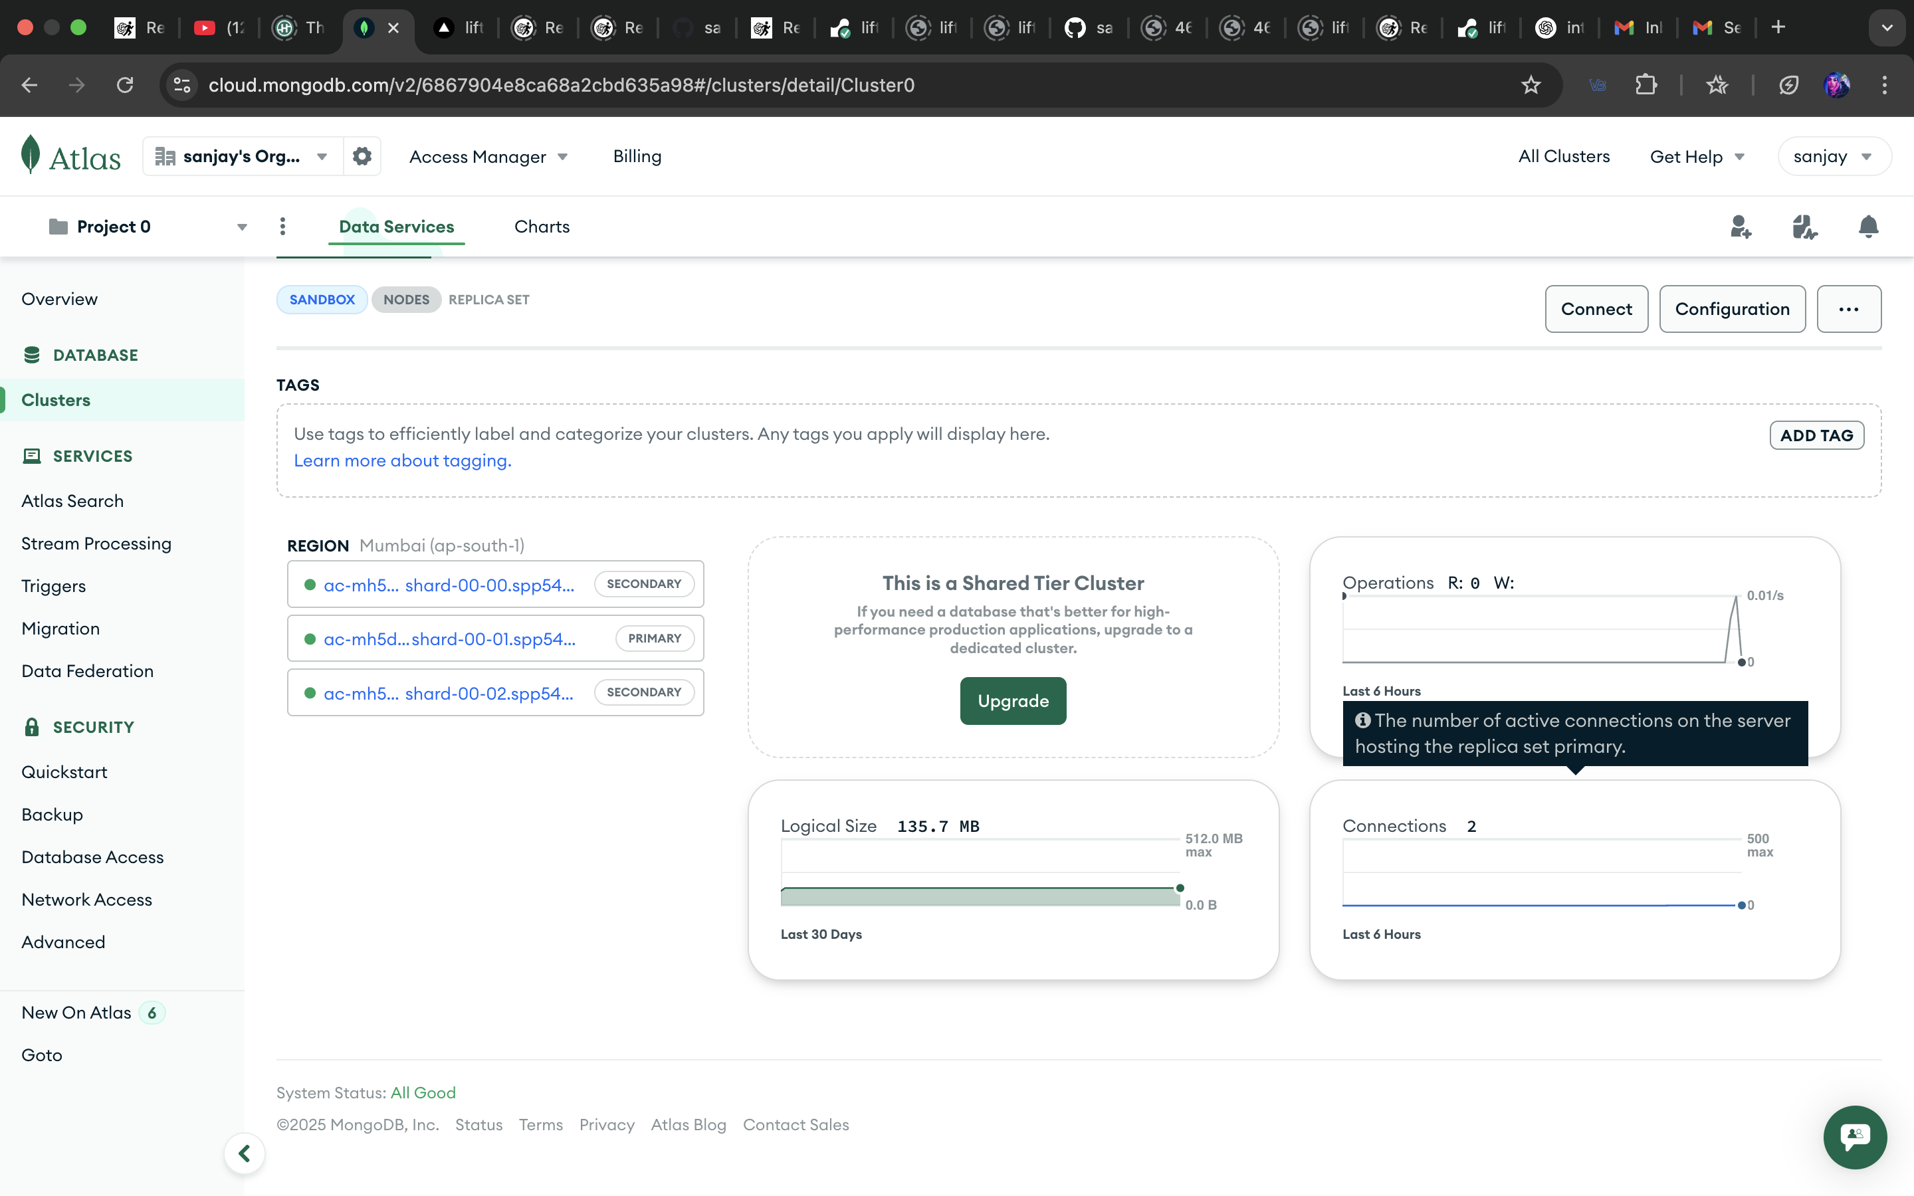
_{database connection}

Slide 26
Future Scope
Improvements (Potential Updates / Add-ons)
Apple Health & Google Fit Integration for seamless fitness data syncing.
Adding Breathing & Meditation modules for mental well-being.
Premium Lofi Music + Diet Chart Subscription for user engagement and monetization.
AI-powered personalized diet planning with advanced macro visualization.
Push notifications for hydration, workout reminders, and motivational quotes.
Gamification elements (badges, streaks, leaderboard) to encourage consistency.
Performance optimizations with advanced caching and CDN usage for scalability.

Slide 27
Next Steps (Future Phases)
Phase 2: Launch the mobile app version for broader reach.
Phase 3: Integrate wearable device connectivity for live step, heart rate, and calorie tracking.
Phase 4: Add a community feature for challenges, groups, and shared goals.
Phase 5: Deploy AI/ML models for predictive health insights, like injury risk and recovery suggestions.
Phase 6: Explore B2B fitness platform partnerships with gyms and dieticians.

Slide 28
LIVE DEMO
drive link for the video:
LIVE DEMO OF FITNESS TRACKER

Slide 29
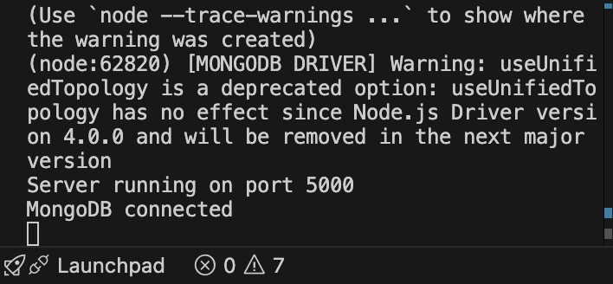
INITIATE DATABASE : npm run dev

Slide 30
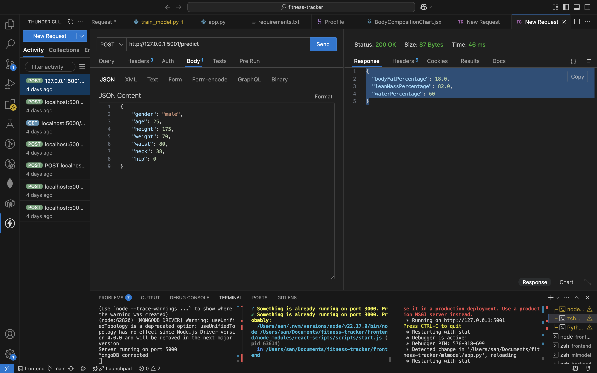
INITIATE frontend : but here it is already running
npm start

Slide 31
Initiate mlmodel : python app.py

Slide 32
First register the login id

Slide 33
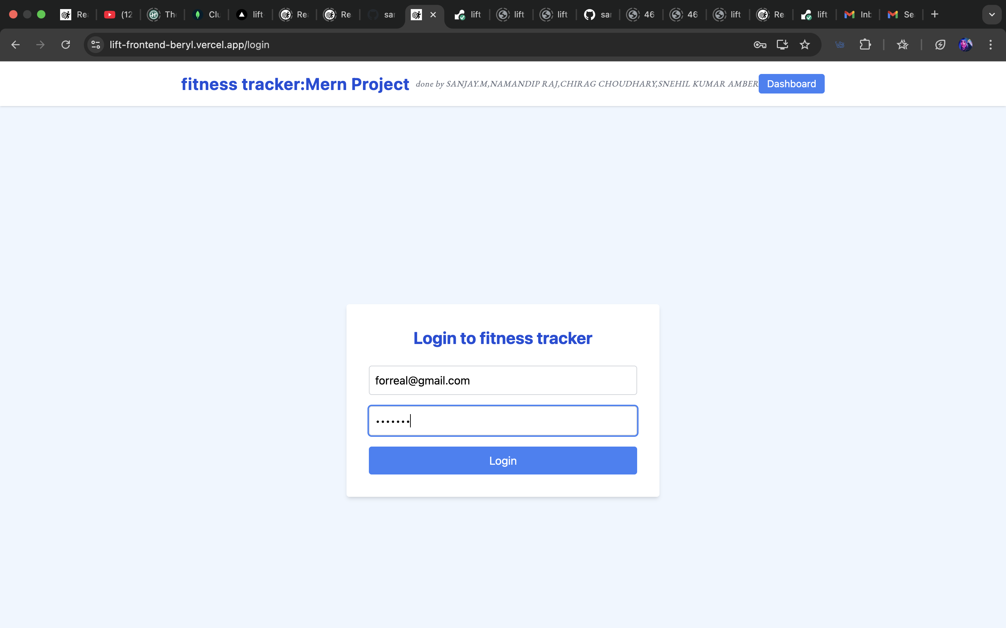
login into the dashboard in login page

Slide 34
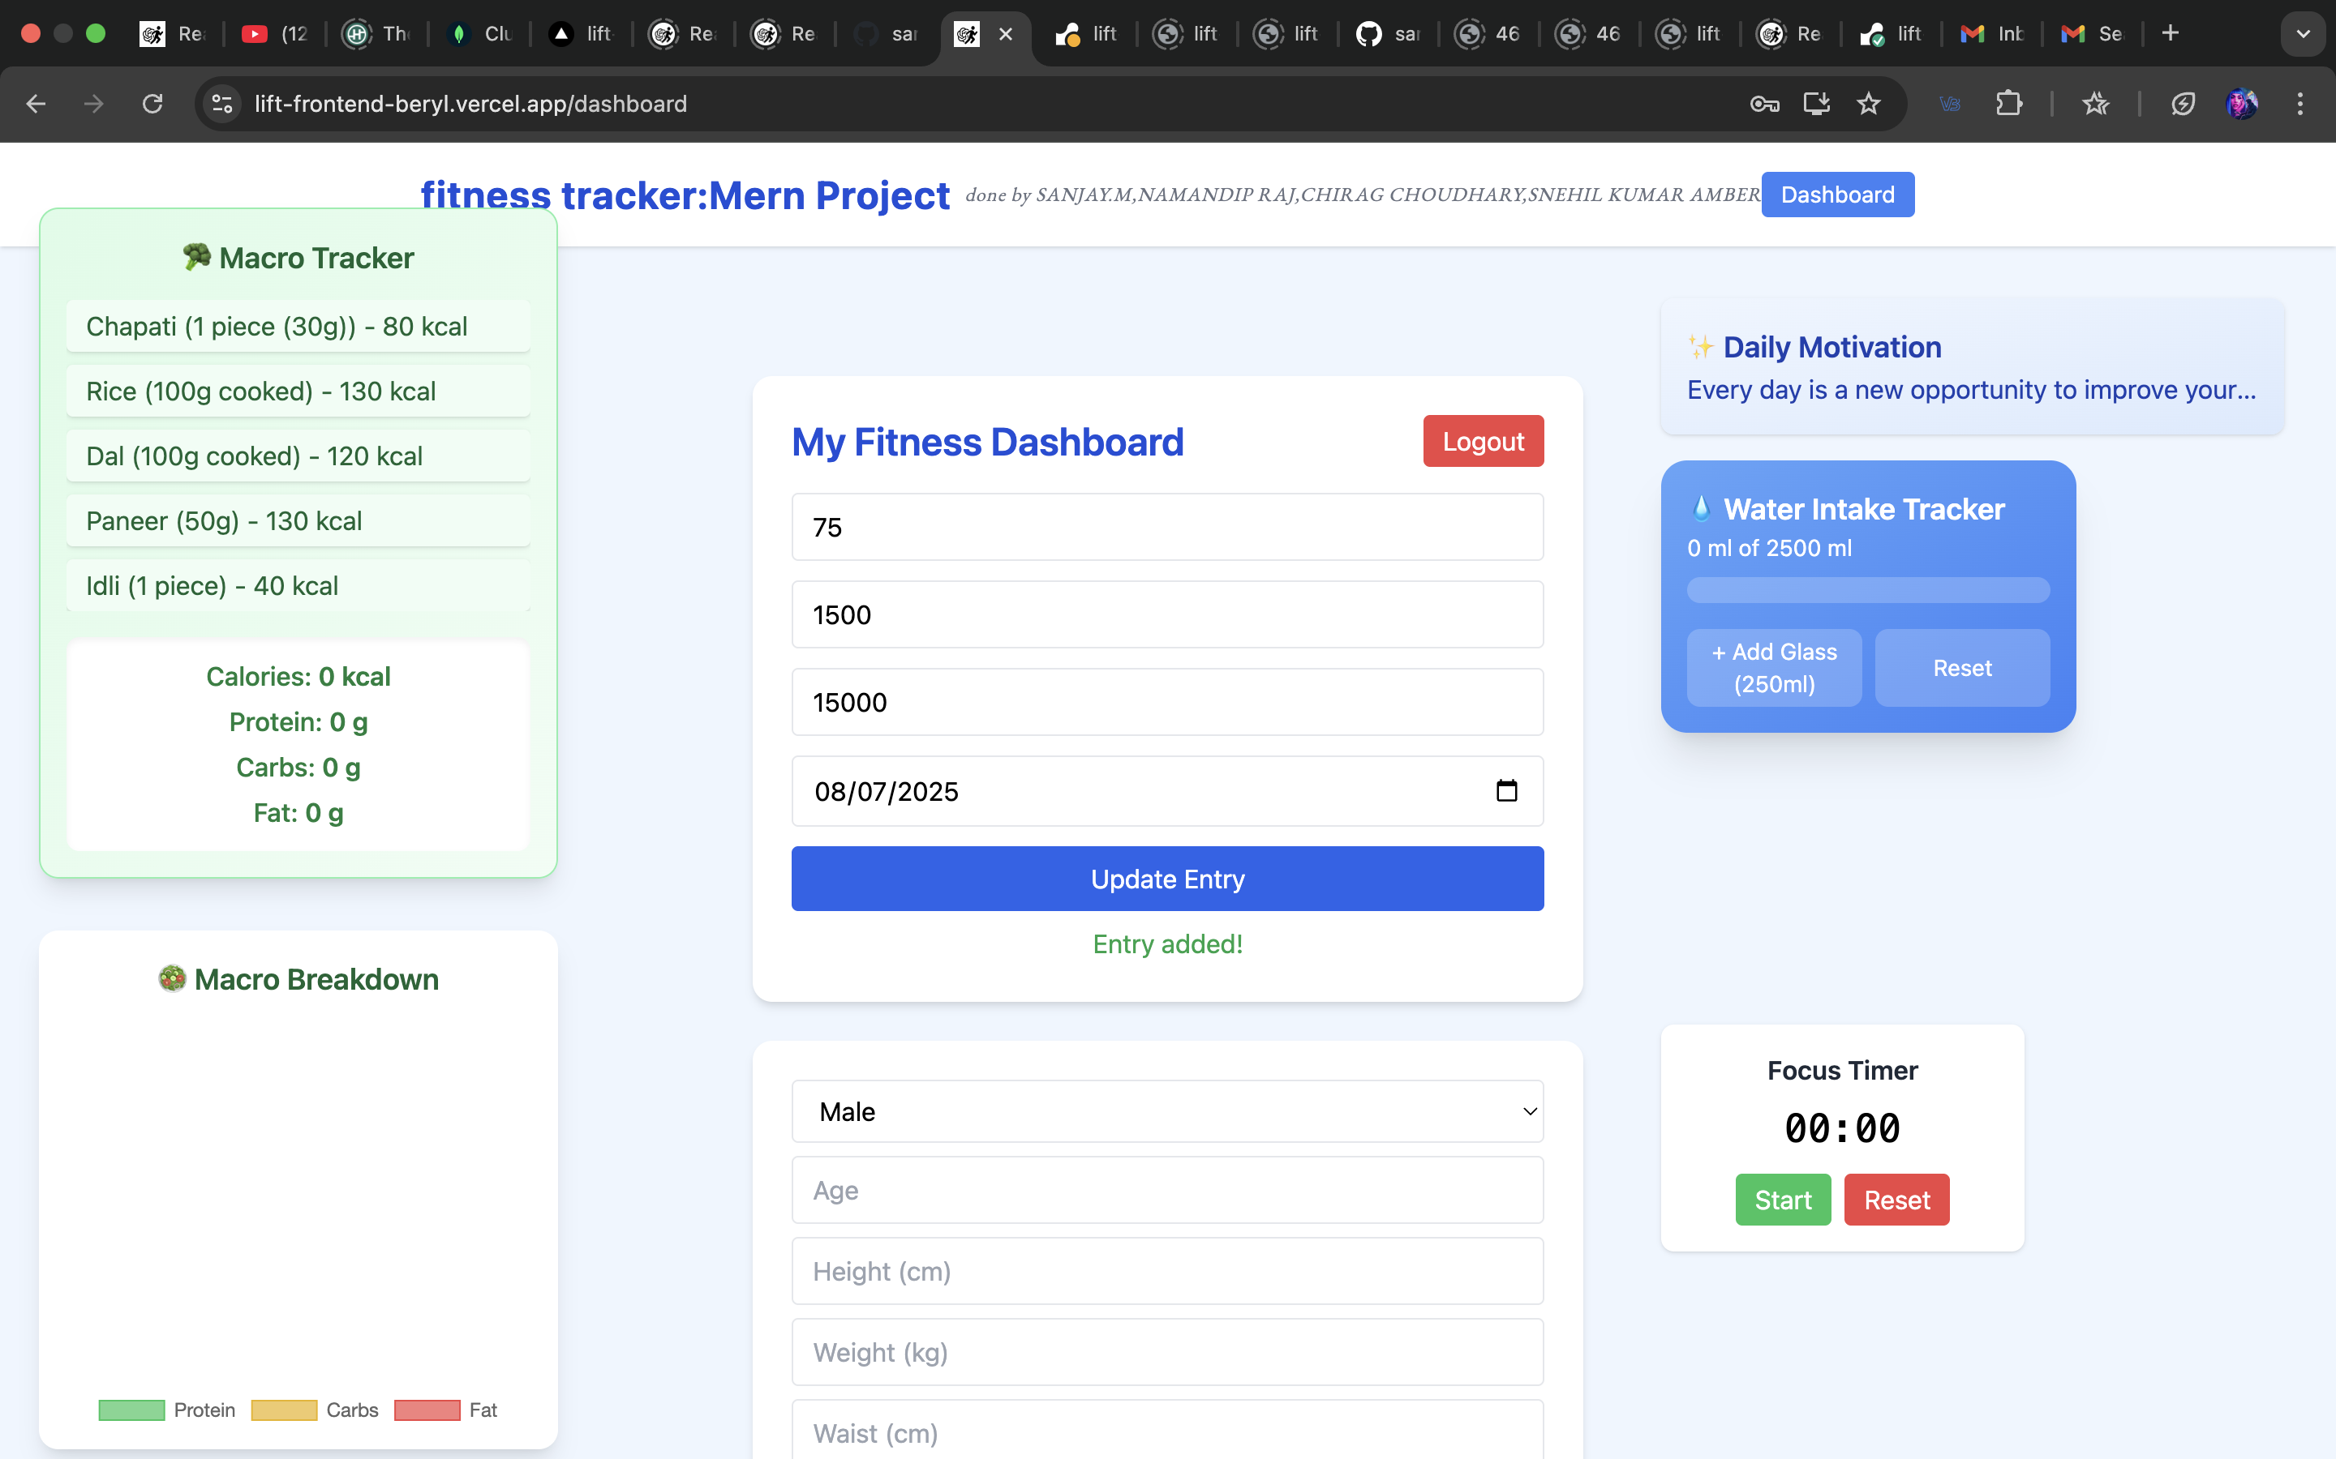
Entry in the daily tracker

Slide 35
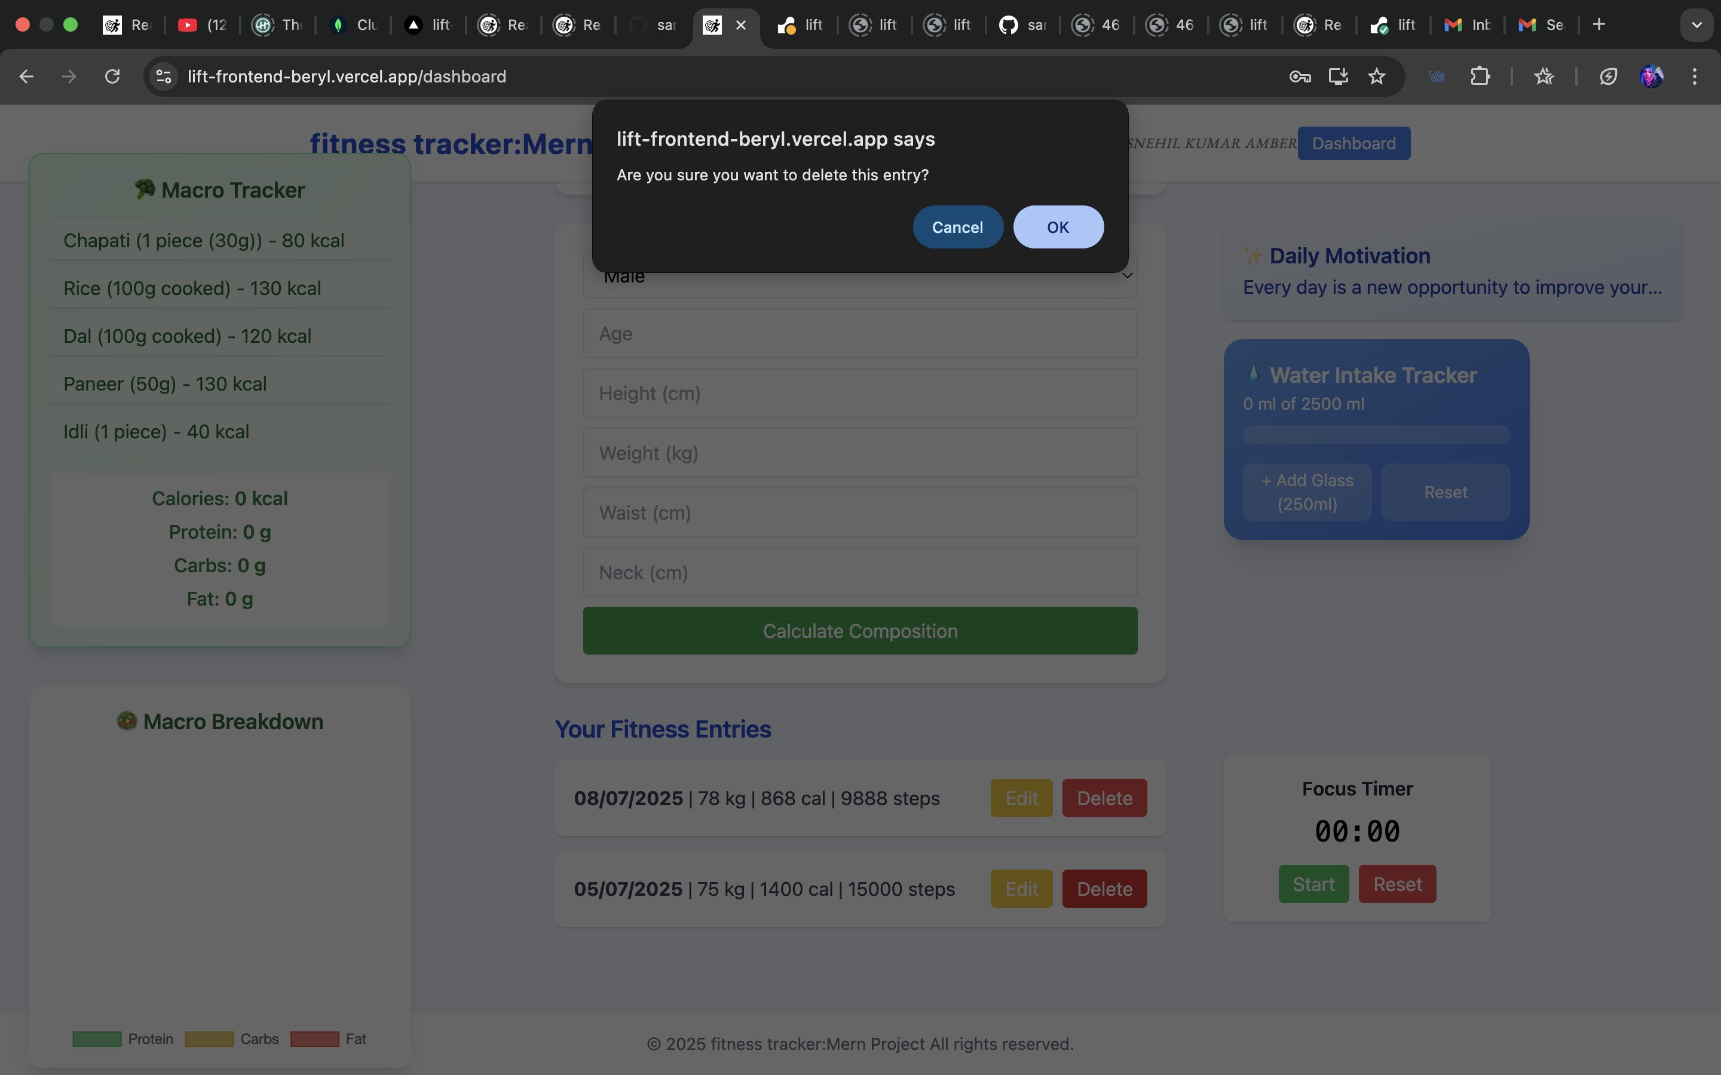
Delete the entry

Slide 36
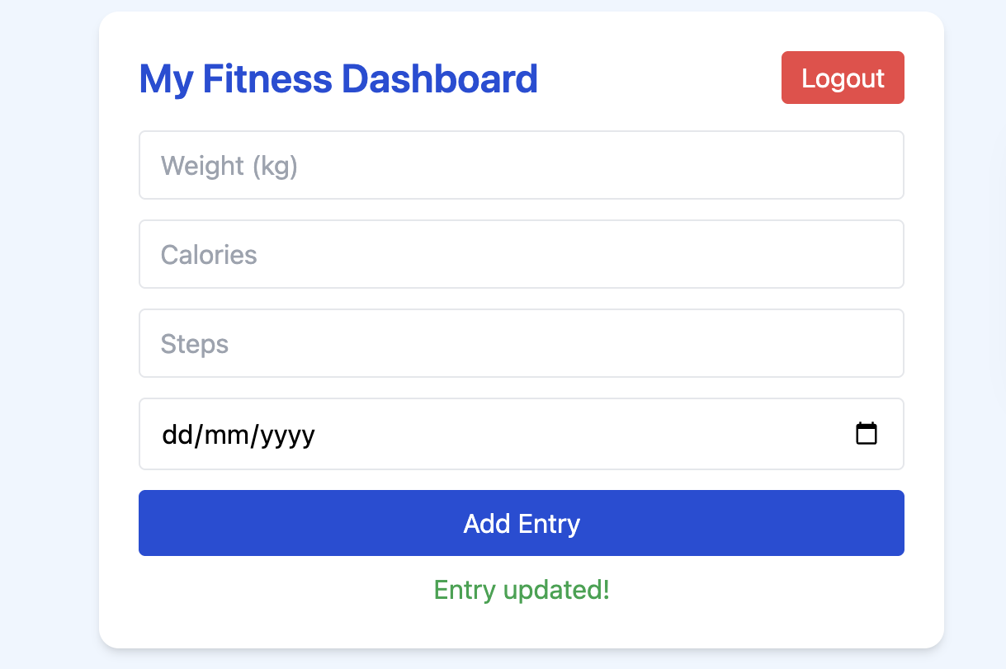
Update the entry

Slide 37

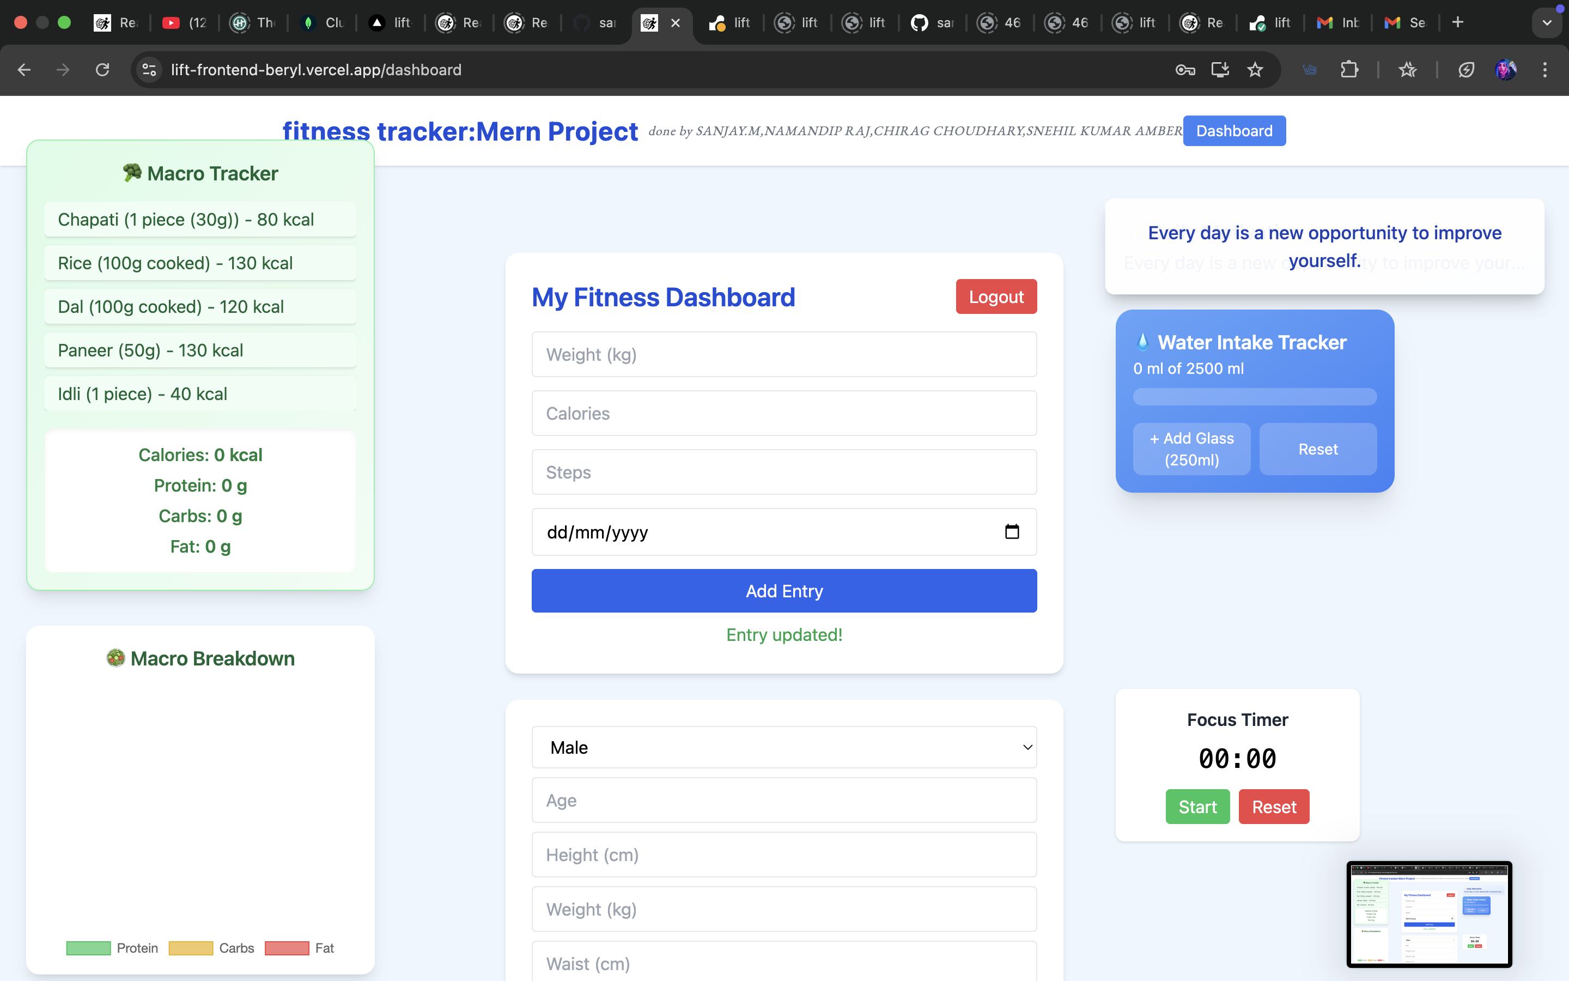
daily motivation quotes for the users to stay motivated(with hover effect)

Slide 38
food macros calculator along with diet chart

Slide 39
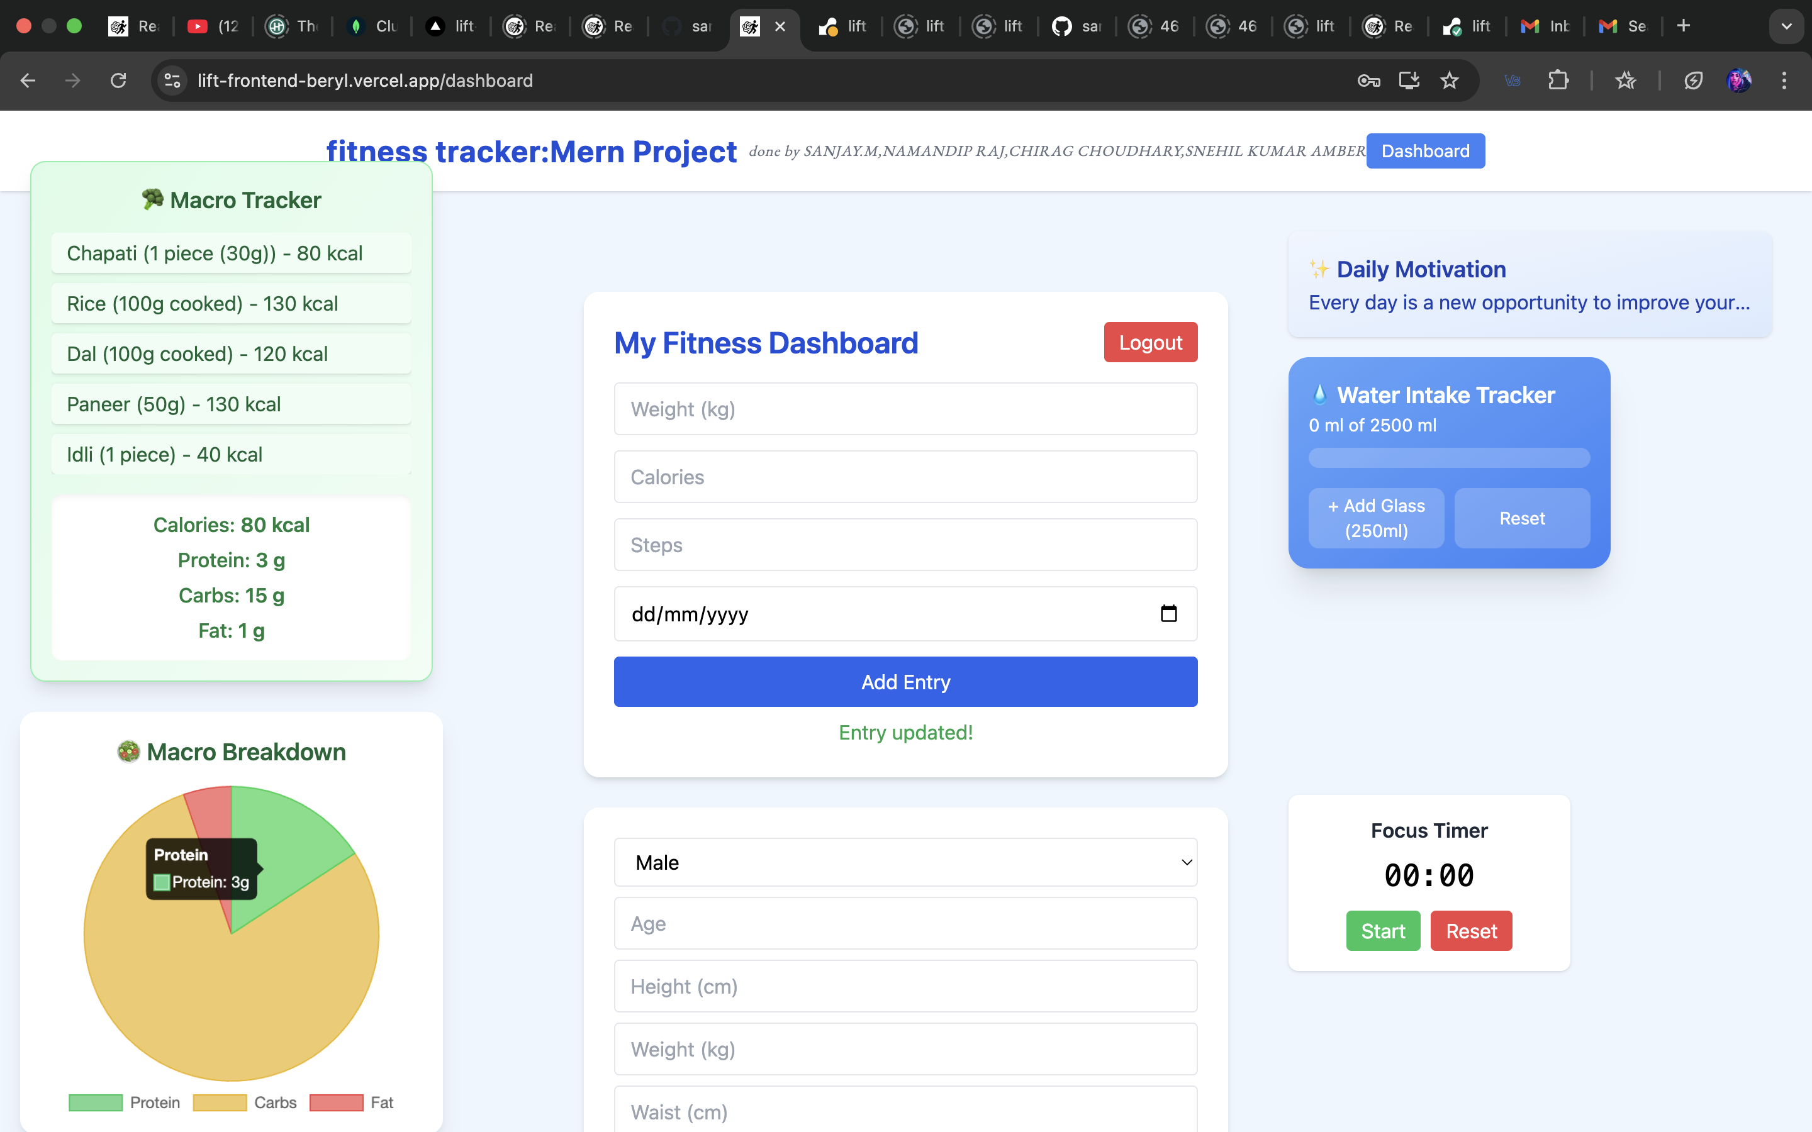
food macros calculator along with diet chart

Slide 40
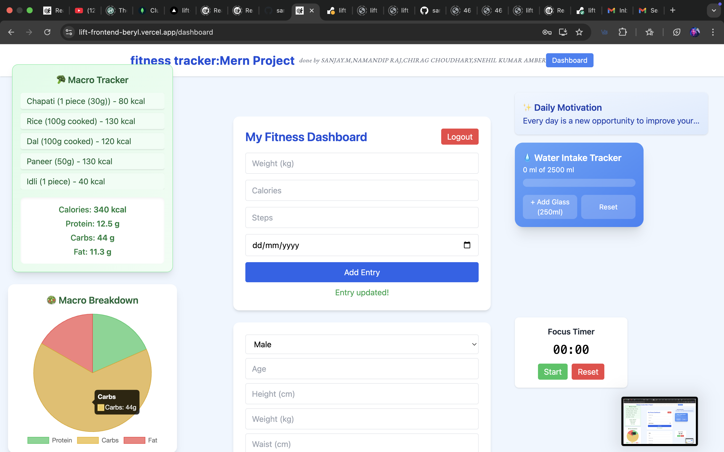
food macros calculator along with diet chart

Slide 41

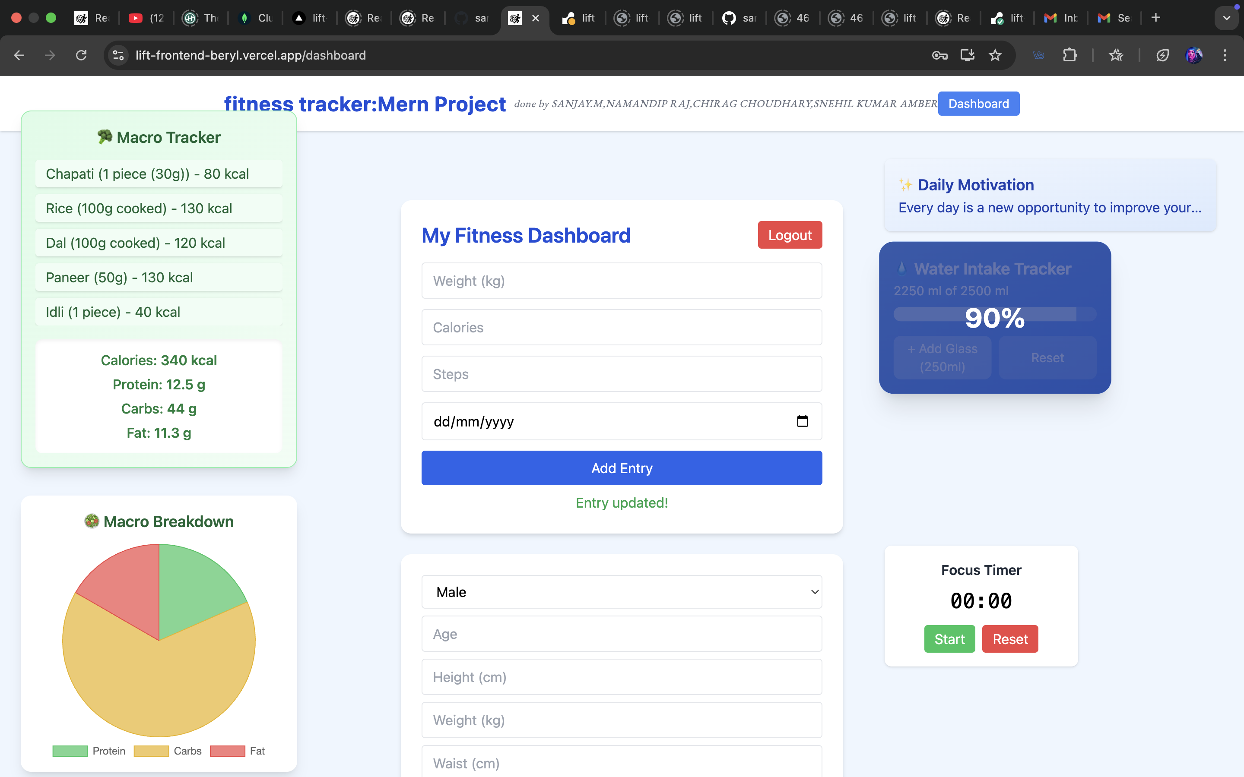

daily water intake reminder: everytime pressing (+ add glass) button it get incremented by 250ml

Slide 42
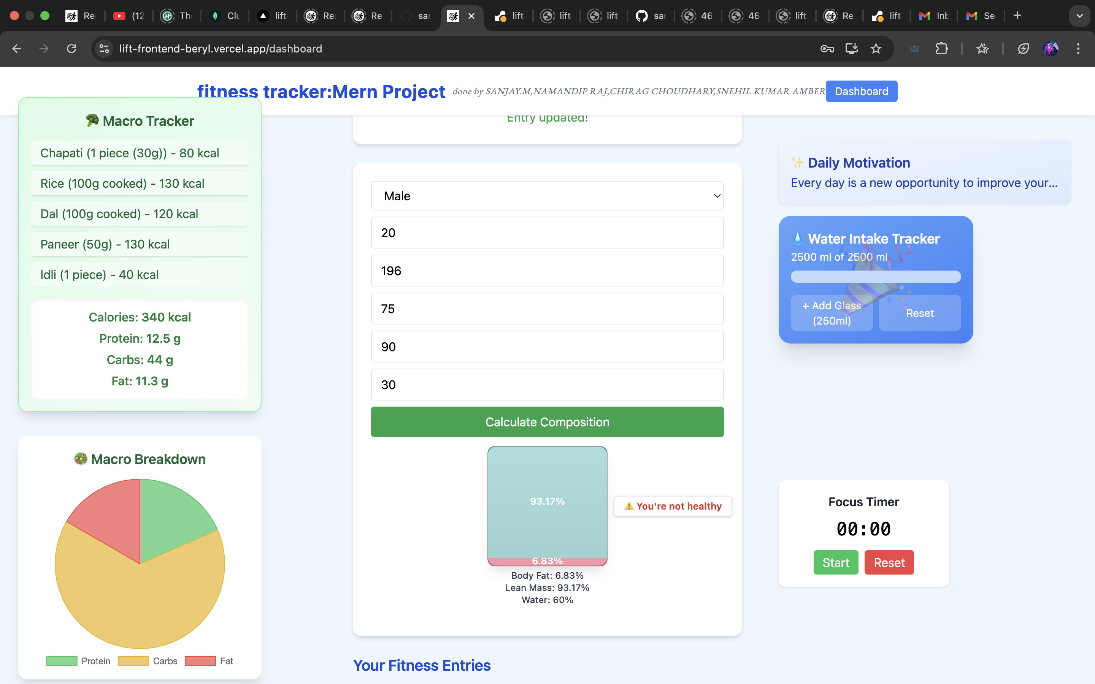

live bmi calculator with health care analysis

Slide 43


LIVE DEMO
focus stopwatch timer

Slide 44

LIVE DEMO
logout after usage

Slide 45
Use Case Highlight
“Busy Professionals & Students maintaining health while working”
Use during study or work breaks to log meals and water intake.
Helps maintain hydration, nutrition, and daily step goals.
Use the Focus Timer for Pomodoro study/work sessions while tracking wellness.
Get predictive body composition insights to plan workouts and meals effectively.
Encourages micro-habits for a healthier lifestyle without disrupting productivity.

Slide 46
Thank You
done by:-
Sanjay M 22BIT0518
Namandip Raj 22BCE11371
Chirag Choudhary 22BCE10993
Snehil Kumar Amber 22BCE11225

